Slide 1
To Make A Choice
Parts 1 & 2
lausd.org/human-relations

Slide 2
Would You Rather
Have a pet crocodile
Have a pet squirrel
lausd.org/human-relations

Slide 3
Pair Share
Name one choice you have already made today
lausd.org/human-relations

Slide 4
My Magical Choices
lausd.org/human-relations
Notes:
https://www.youtube.com/watch?v=usM22MEOhuI

Slide 5
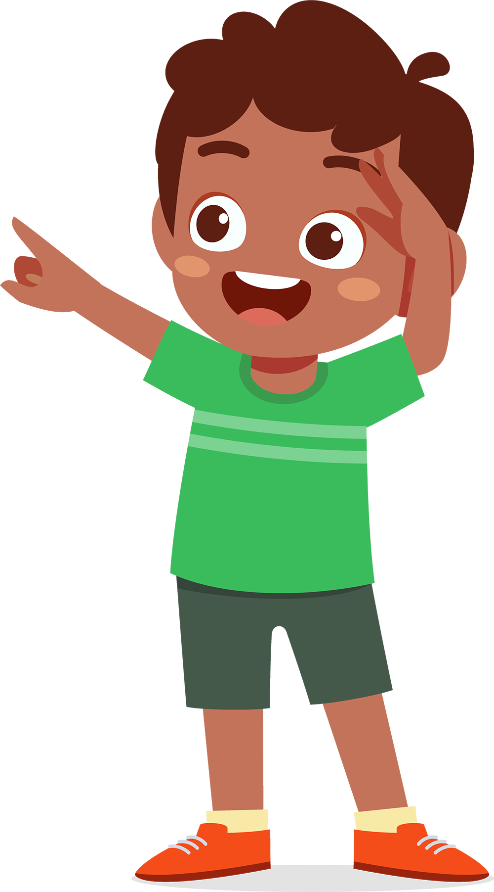
Pair Share
Name some examples of choices that were discussed in the story
lausd.org/human-relations

Slide 6
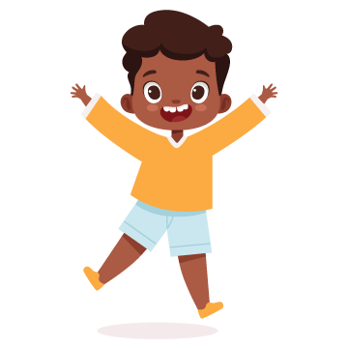
Giving vs. Getting Help
Helping others can:
Make you feel good
Help you feel important
Most people like to be helpful.
lausd.org/human-relations

Slide 7
Type of Choices
We make thousands of choices a day
Some choices can feel like BIG choices
Other choices we make so often they become routine
Some choices we are making for the first time
Other choices we have been making since we were small
lausd.org/human-relations

Slide 8
Daily Choices
Some choices we make every day include:
What to wear
Whether we brush our hair and teeth, wash our face, etc.
What to eat or drink and when
Who we will hang out with
lausd.org/human-relations

Slide 9
Habits
Some choices we make so often they become a habit.
Healthy habits can help us create a healthy future.
Healthy habits may include:
Getting enough sleep
Drinking enough water
Moving your body
Being a good friend
lausd.org/human-relations

Slide 10
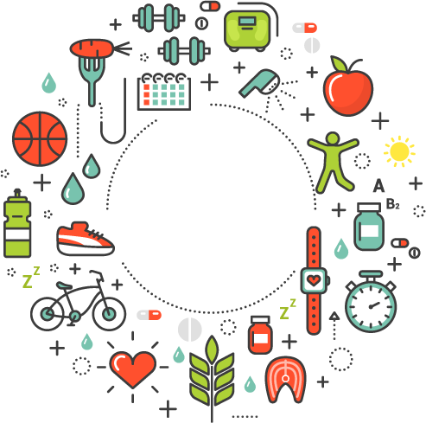
Pair Share
What healthy habits do you currently have?
?
lausd.org/human-relations

Slide 11
How We Make Choices
There are lots of ways to make a choice.
You could flip a coin.
Trust your gut and do what you feel
Avoid thinking all together and just make a choice at random
These techniques may work for smaller decisions, but big ones definitely need more thought!
lausd.org/human-relations

Slide 12
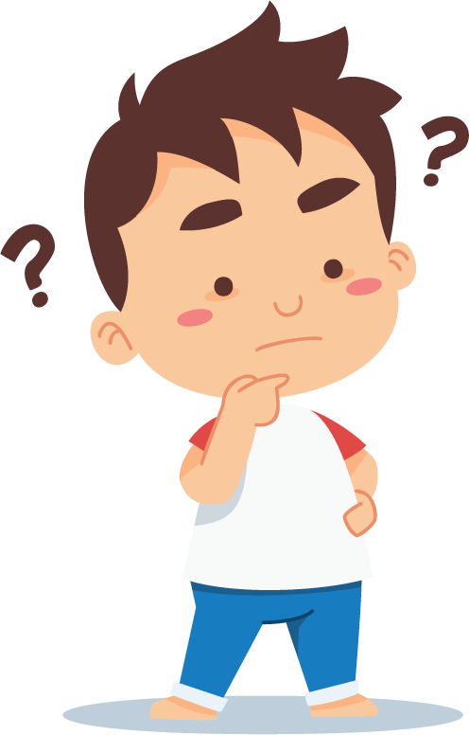
How Our Choices Make us Feel
Some choices we make every day include:
Sometimes the choices we make can make a big difference.
Our choice can affect how we, and the people around us feel, depending on what we choose.
lausd.org/human-relations

Slide 13
Do My Choices Matter?
lausd.org/human-relations
Notes:
https://youtu.be/6cxt_Ki4GSo

Slide 14
Stop and Breathe
When we feel upset, it might be really tempting to say or do something that isn't nice.
But, we have more choices than that.
What you do, is up to you!
lausd.org/human-relations

Slide 15
Let the Big Feeling Pass
When something happens and you get frustrated or annoyed, think RED LIGHT and STOP.
Stop talking, do nothing.
Next, think YELLOW LIGHT.
take deep breaths on purpose.
think about our choices
Last, GREEN LIGHT:
make the choice that will help us and those around us feel better.
lausd.org/human-relations

Slide 16
Pair Share
Using the Stoplight can help us make better choices.
The Yellow Light tells us to pause and take deep breaths.
Share about a time where taking deep breaths helped you make a better choice.
lausd.org/human-relations

Slide 17
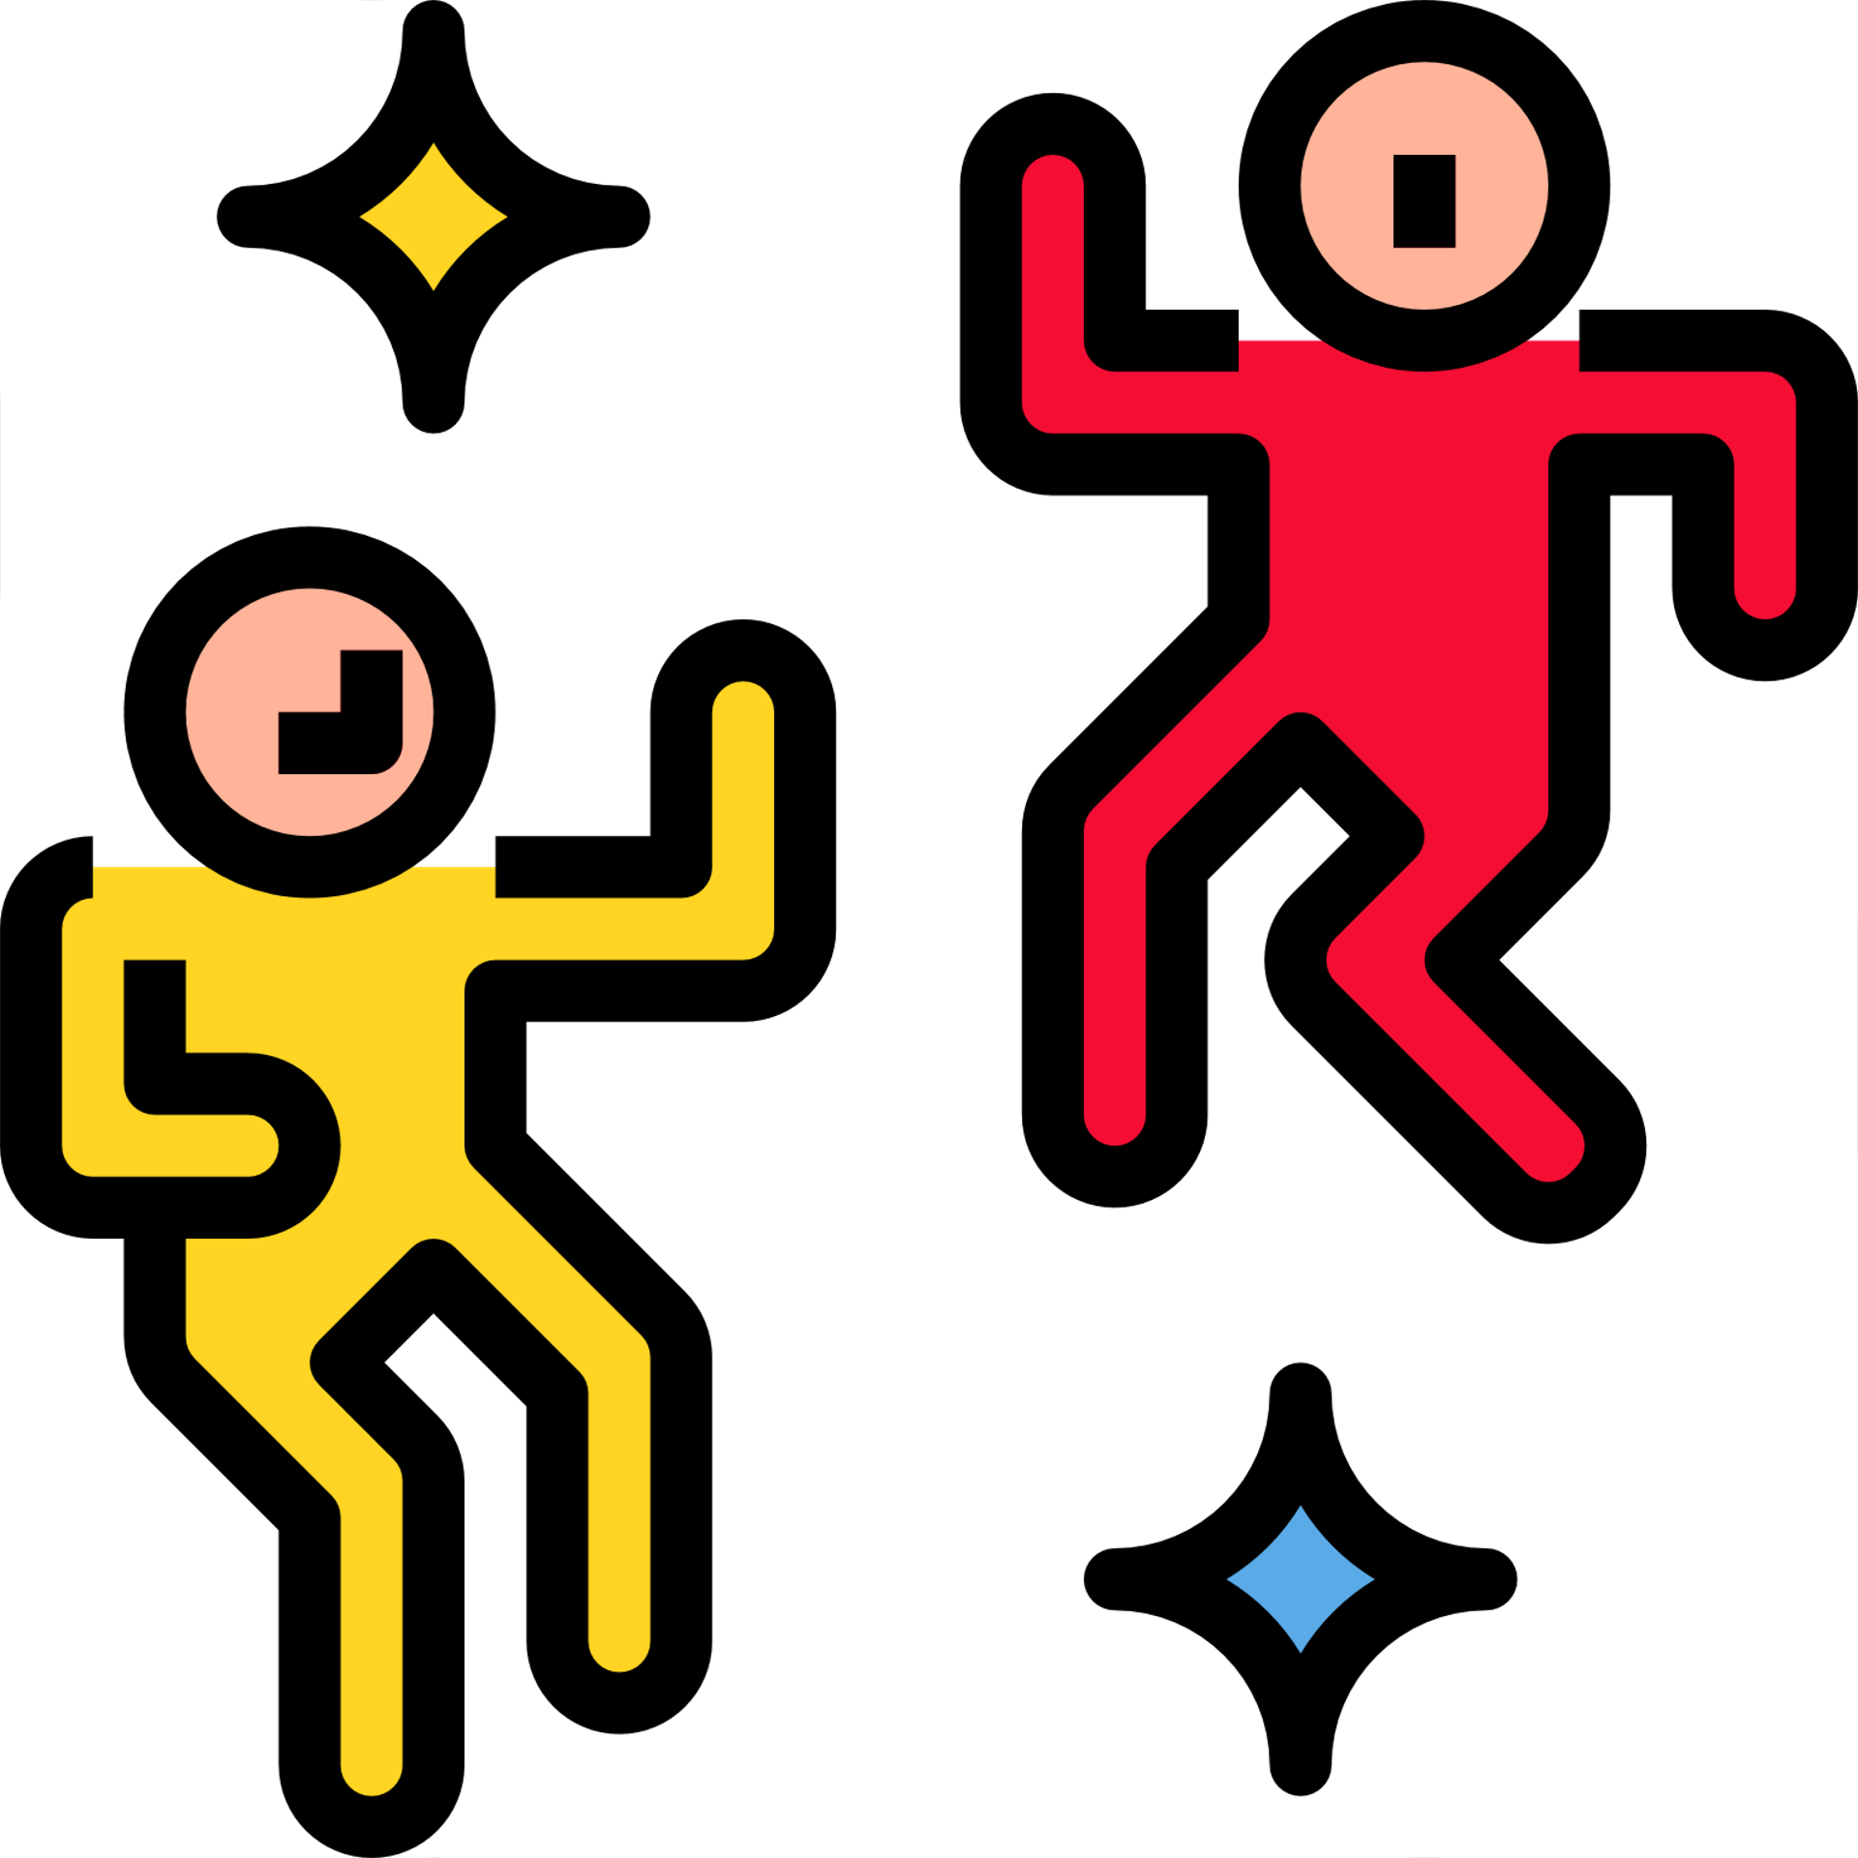
Check Out
What will you do for yourself today?
Journal on how you feel today
Write a poem or a short story
Create a mood music playlist
Find a new exciting thing
Listen to a podcast or music
Cook your favorite meal

Slide 18
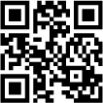
Committed to fostering a safe and respectful District, school and community culture where the seeds of peace and justice are down so that all students and staff can lead safe, purposeful and academically fruitful lives.
Connect with us at bit.ly/LAUSD-HRDE
lausd.org/human-relations

